Slide 1


Notes:
Welcome to women who code rva!
So excited to be here kicking off our first event of the women who code chapter

Slide 2
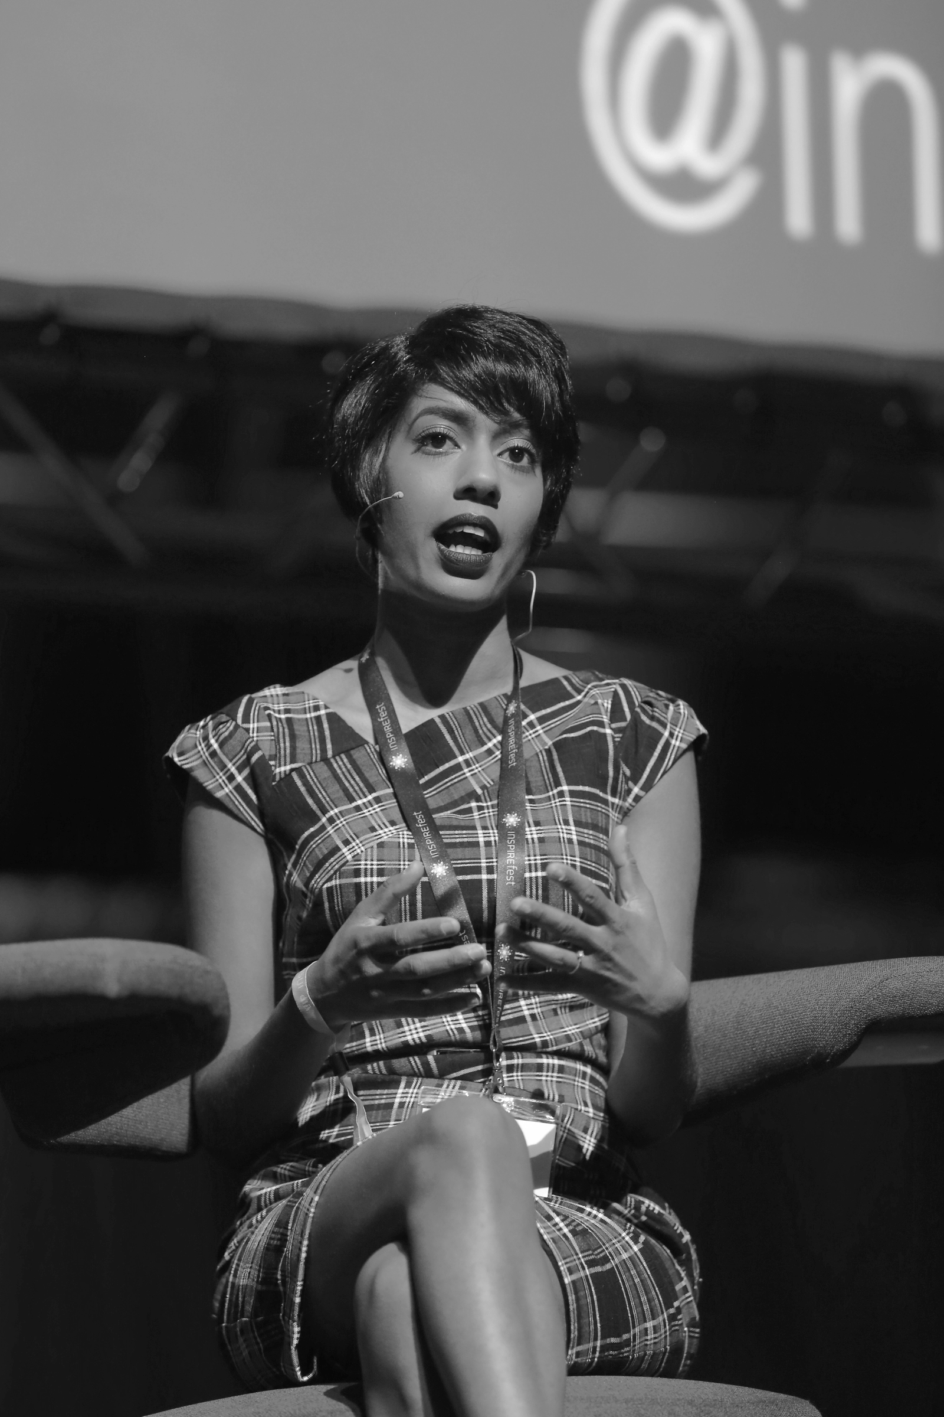
OUR MISSION
Inspiring women to excel in technology careers.
Notes:
- introduce yourself, the orginization, what we do in richmond,
Inspire women to EXCEL and stay in techonology careers, by offering skill building and networking events like tonights! Connect you with the engineers in our area hear their stories, share information, and build a network
Women Who Code prepares this generation of women in tech to be tomorrow’s role models.

Slide 3
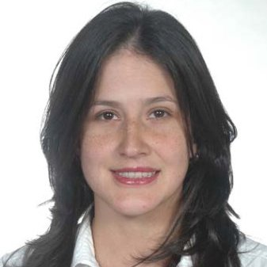
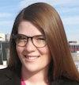

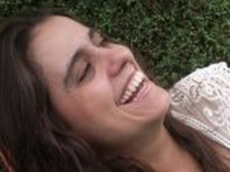
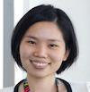
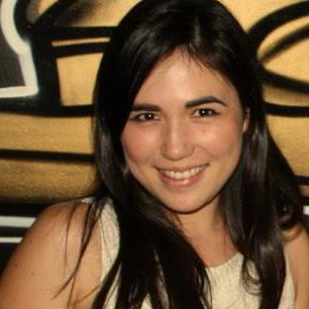
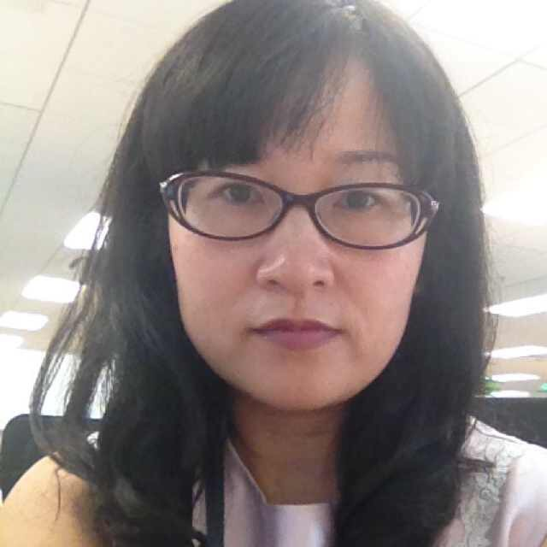
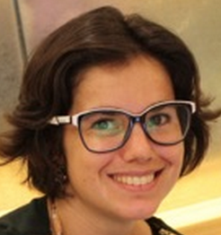
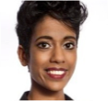
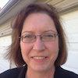
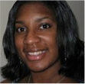


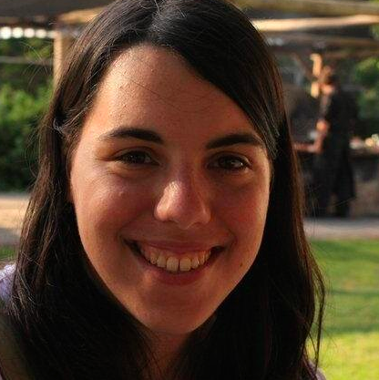
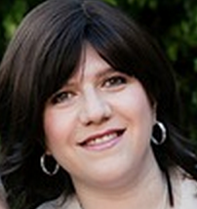
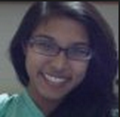

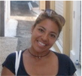
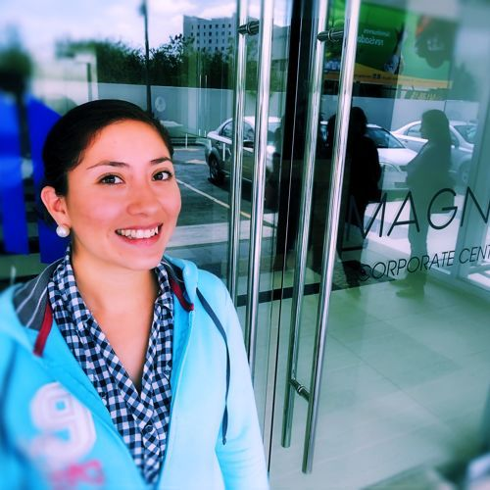
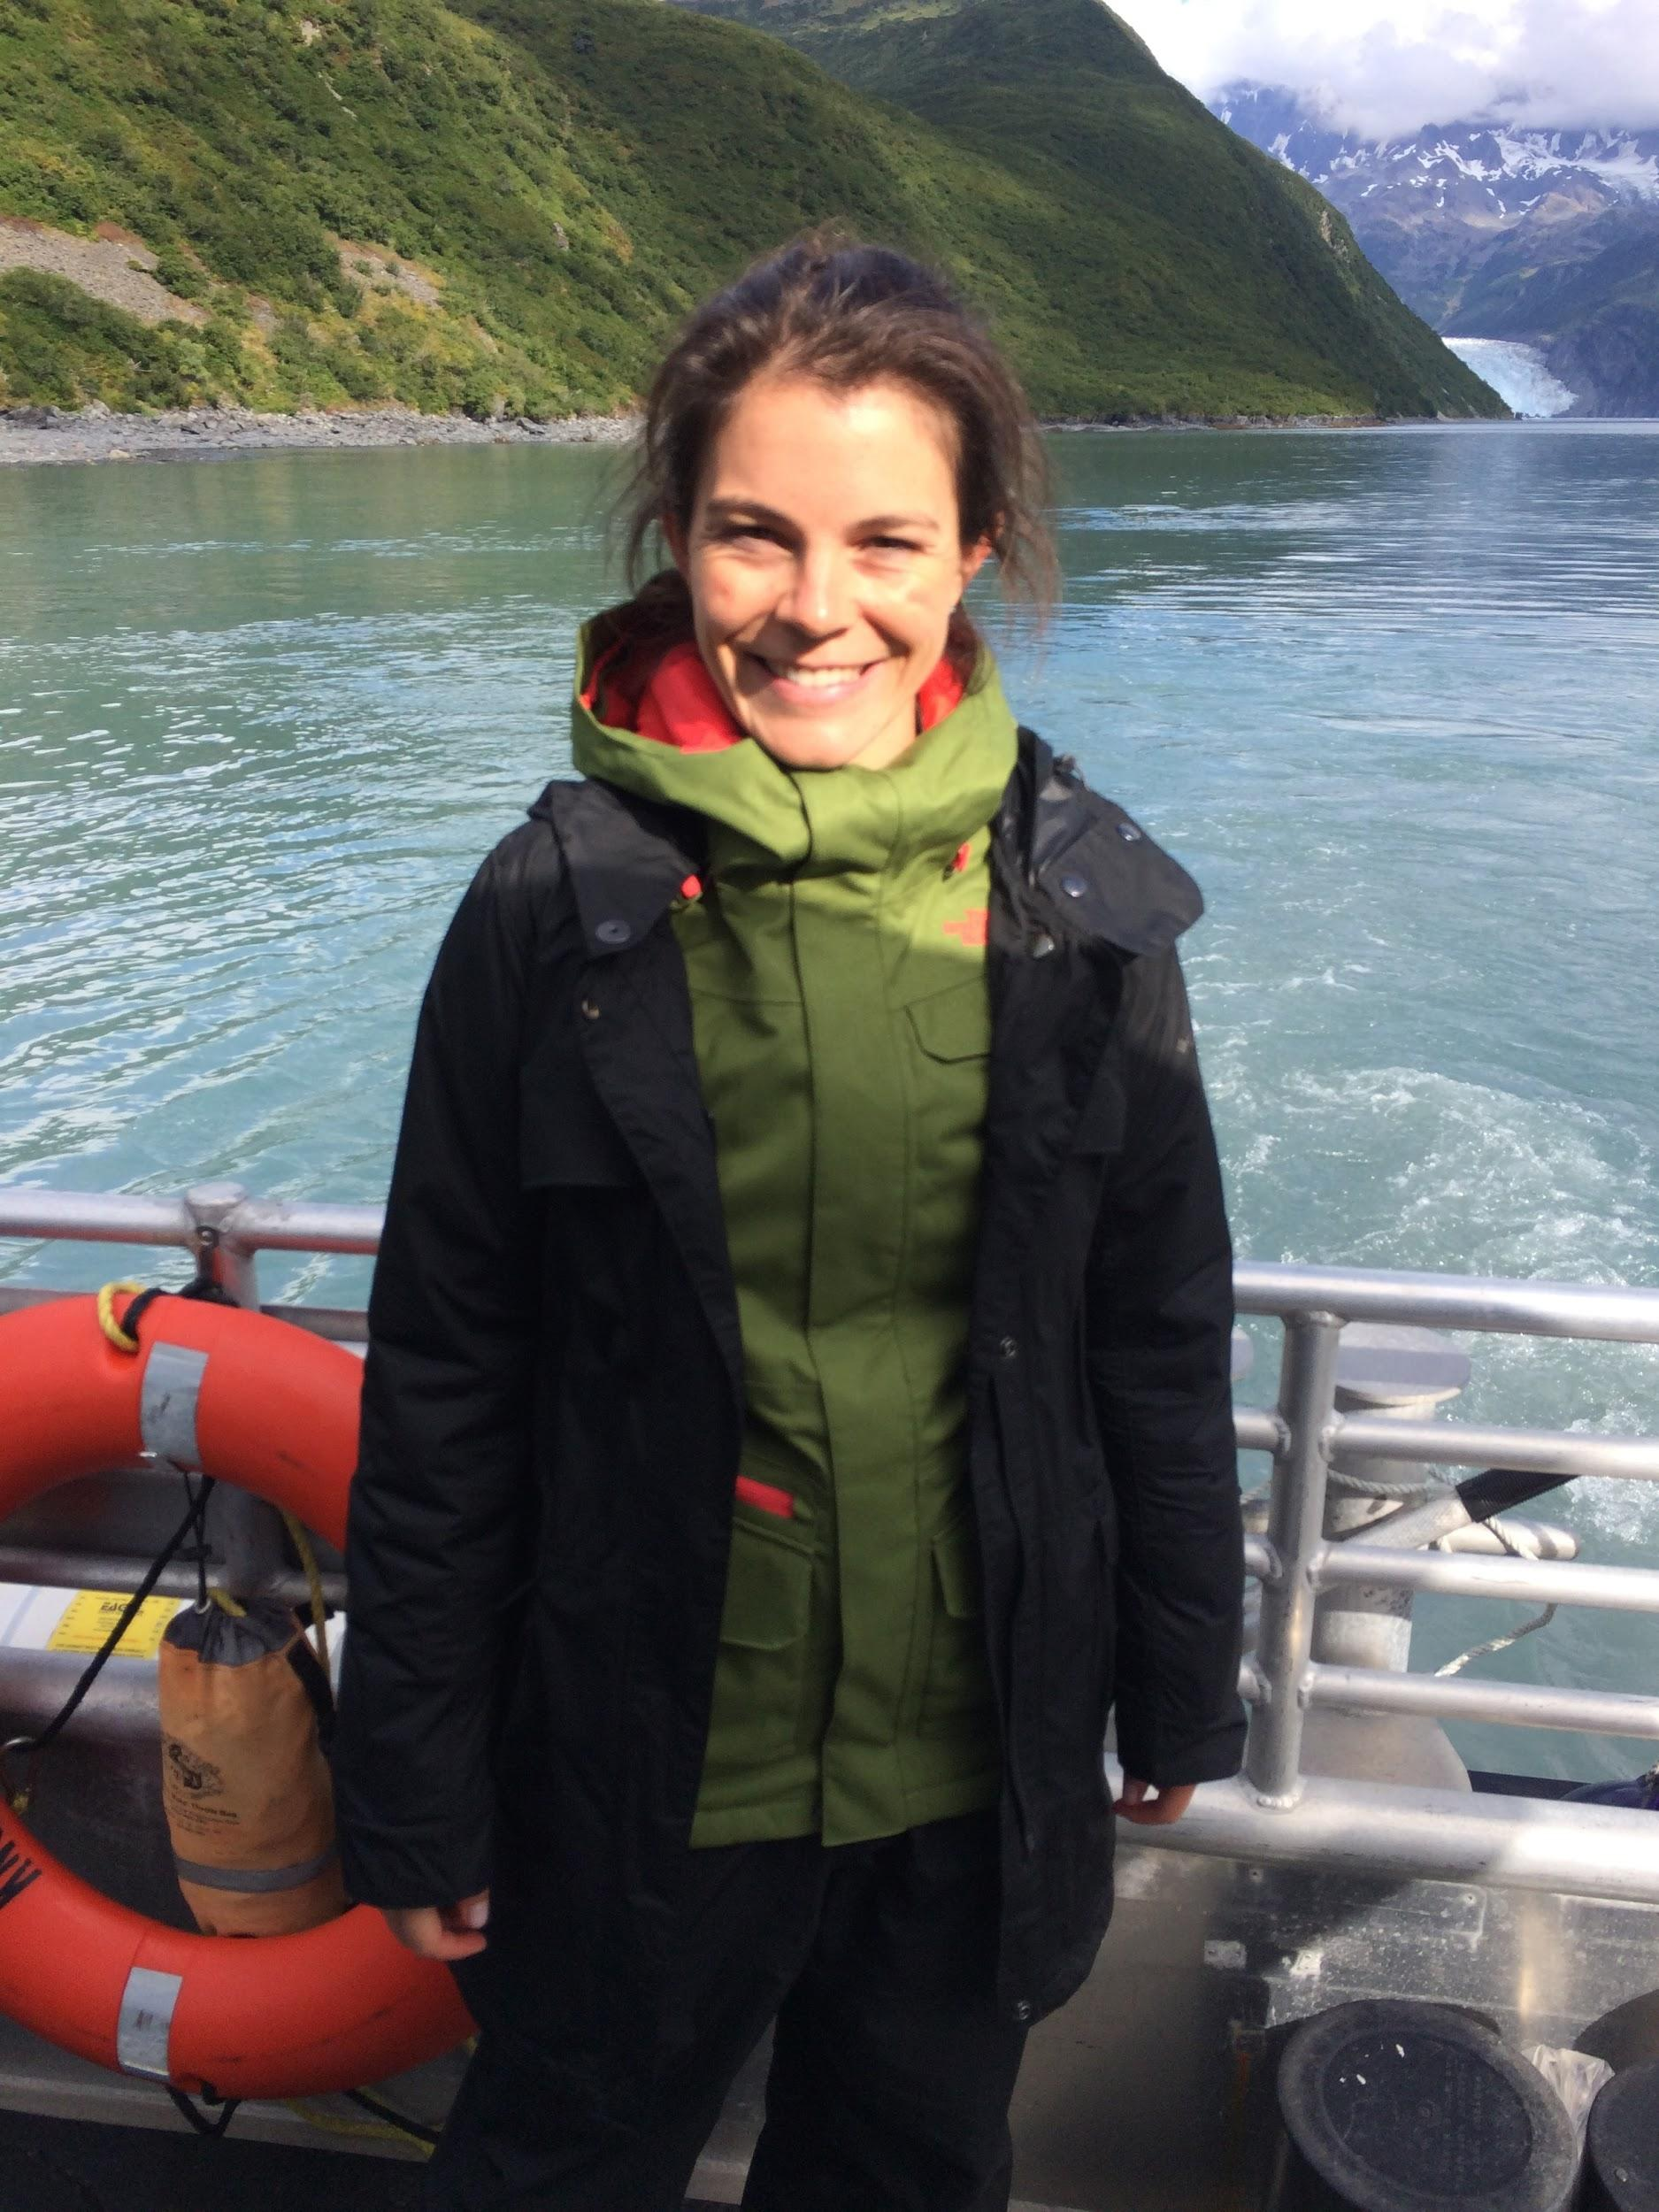
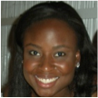
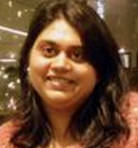
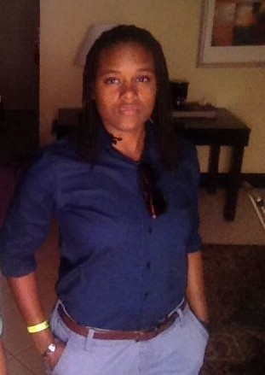
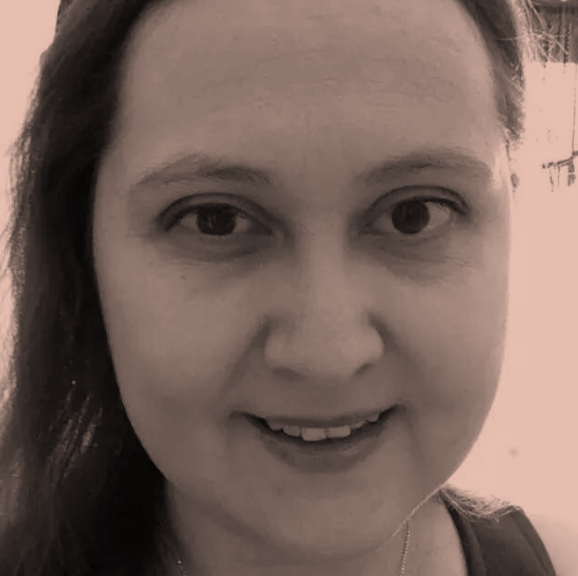
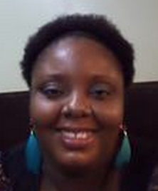
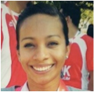
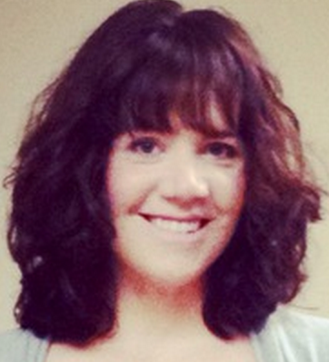
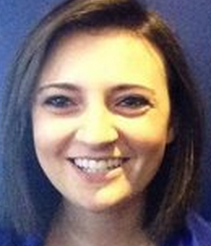
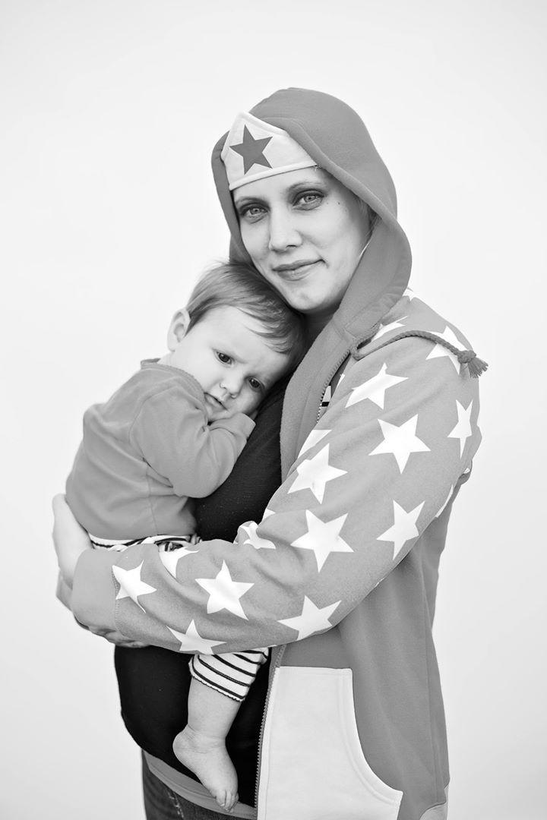

Our networks are led by 400+ volunteer leaders who help propel women in tech
Notes:
Wwcode is powered by 400+ volunteers and We couldnt bring this network together without an aweseome core team some of whom you will hear from tonight.
Request for those interested in hosting an event, presenting, helping iwth one idea or joinging our core team to connect with us

Slide 4


THANK YOU!
Notes:
Our events are also not possible without our event hosts and sponsors .
5 min opportunity for host or spsonsor to speak
Give floor to vcu
Give floor to capital one

Slide 5
CODE OF CONDUCT
Women Who Code (WWCode) is dedicated to providing an empowering experience for everyone who participates in or supports our community, regardless of gender, gender identity and expression, sexual orientation, ability, physical appearance, body size, race, ethnicity, age, religion, socioeconomic status, caste, or creed. Our events are intended to inspire women to excel in technology careers, and anyone who is there for this purpose is welcome. Because we value the safety and security of our members and strive to have an inclusive community, we do not tolerate harassment of members or event participants in any form. Our Code of Conduct applies to all events run by Women Who Code, Inc. If you would like to report an incident or contact our leadership team, please submit an incident report form.
Notes:
make everyone aware code of conduct that applies to all events Available online to read in its entirety
-empowering experience for everyone.
-inclusive, events are safe and supportive space for all participants
-not tolerate harassment from any members

Slide 6
Let’s Play War!
Slide for introductions/ice breaker (can remove and just go around the room)

Slide 7


Slide 8
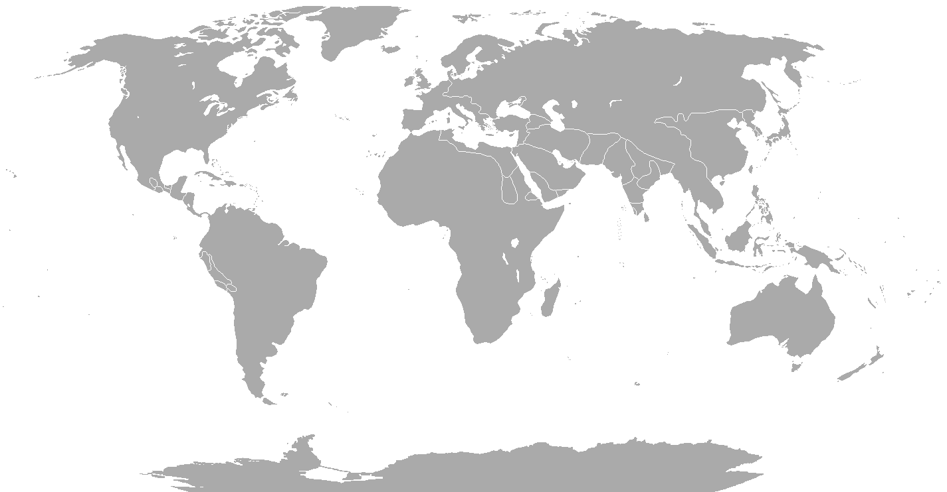

Notes:
Introduce topic speaker and activity… usualy about an hour to 1.5 hours of material

Slide 9
#ApplaudHer

Slide 10
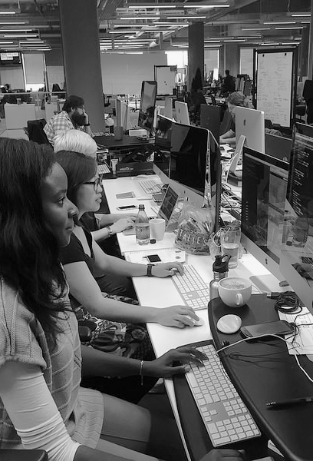
Future Events
SATURDAY, SEPTEMBER 30, 2017 @ 804RVA
WOMEN WHO CODE COFFEE & DONUT SOCIAL
TUESDAY, OCTOBER 10, 2017 @ WEST CREEK TOWN CENTER
THE WOMEN WHO CODE RICHMOND BIRTHDAY PARTY!!
WEDNESDAY, OCTOBER 11, 2017 @ AUTHENTIC
WOMEN WHO CODE ALGORITHMS COMMUNITY
Notes:
BE SURE TO UPDATE THE FUTURE EVENTS SLIDE

Slide 11
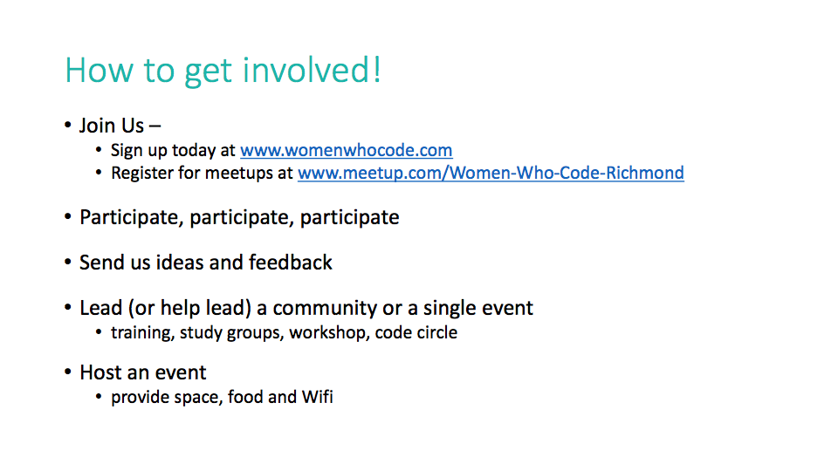
Stay Connected
womenwhocode.com/richmond
meetup.com/women-who-code-richmond
@wwcoderichmond
https://wwcrva-slack.herokuapp.com/
Notes:
Briana

Slide 12
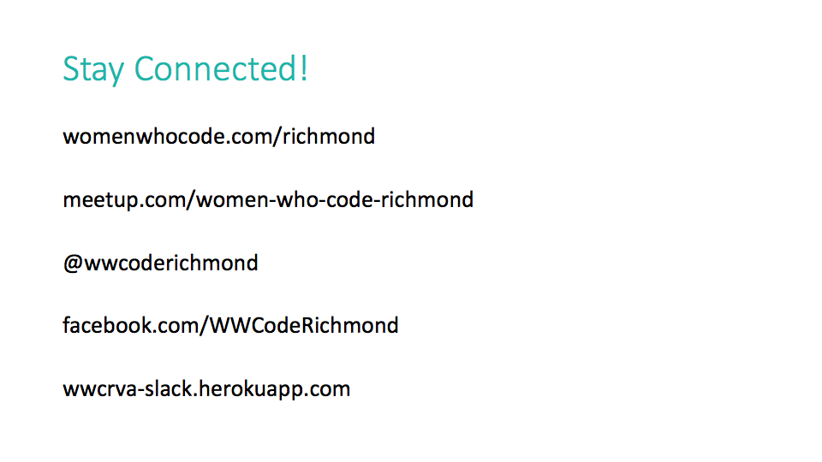

Slide 13

THANK YOU!
Notes:
Briana and Michele

